Slide 1
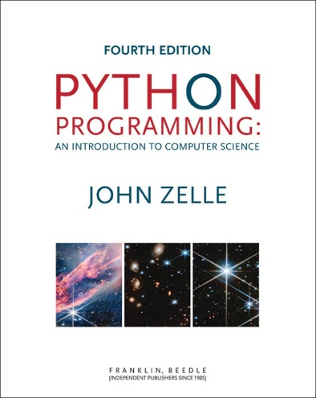
Python Programming: An Introduction To Computer Science
Chapter 9
Data Collections

Slide 2
Objectives
To understand the use of lists (arrays) to represent a sequential collection of data.
To be familiar with the functions and methods available for manipulating Python lists.
To understand the use of tuples for grouping a set of related values.
To be familiar with Python dictionaries as a data structure for storing non-sequential collections.

Slide 3
Objectives
To be able to write programs that use lists and tuples to structure and manipulate collections of information.

Slide 4
Example Problem: Simple Statistics
Many programs deal with large collections of similar information.
Words in a document
Students in a course
Data from an experiment
Customers of a business
Graphics objects drawn on the screen
Cards in a deck

Slide 5
Example Problem: Simple Statistics
Let’s review some code we wrote in chapter 7:
# average4.py
# A program to average a set of numbers
# Illustrates sentinel loop using empty string as sentinel
def main():
sum = 0.0
count = 0
xStr = input("Enter a number (<Enter> to quit) >> ")
while xStr != "":
x = float(xStr)
sum = sum + x
count = count + 1
xStr = input("Enter a number (<Enter> to quit) >> ")
print("\nThe average of the numbers is", sum / count)

Slide 6
Example Problem: Simple Statistics
This program allows the user to enter a sequence of numbers, but the program itself doesn’t keep track of the numbers that were entered – it only keeps a running total.
Suppose we want to extend the program to compute not only the mean, but also the median and standard deviation.

Slide 7
Example Problem: Simple Statistics
The median is the data value that splits the data into equal-sized parts.
For the data [2, 4, 6, 9, 13], the median is 6, since there are two values greater than 6 and two values that are smaller.
One way to determine the median is to store all the numbers, sort them, and identify the middle value.

Slide 8
Example Problem: Simple Statistics
The standard deviation is a measure of how spread out the data is relative to the mean.
If the data is tightly clustered around the mean, then the standard deviation is small. If the data is more spread out, the standard deviation is larger.
The standard deviation is a yardstick to measure/express how exceptional a value is.

Slide 9




Example Problem: Simple Statistics
The standard deviation is
Here is the mean, represents the i^{th} data value and n is the number of data values.
The expression is the square of the “deviation” of an individual item from the mean.
$$s=\sqrt{\frac{\sum{{\left(\bar{x}−x_{i}\right)}^{2}}}{n−1}}$$
$$\bar{x}$$
$$x_{i}$$
$${\left(\bar{x}−x_{i}\right)}^{2}$$

Slide 10
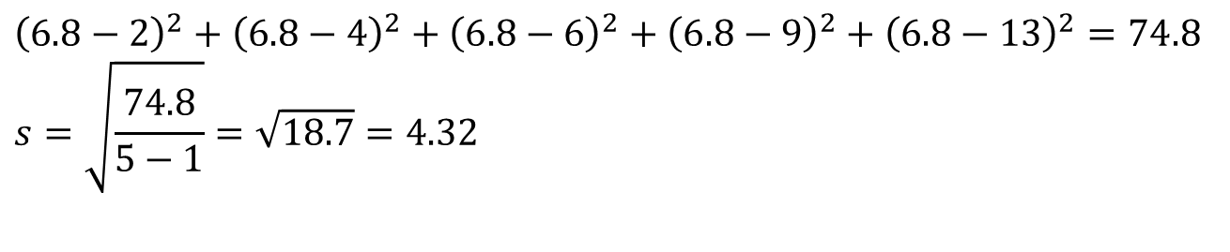
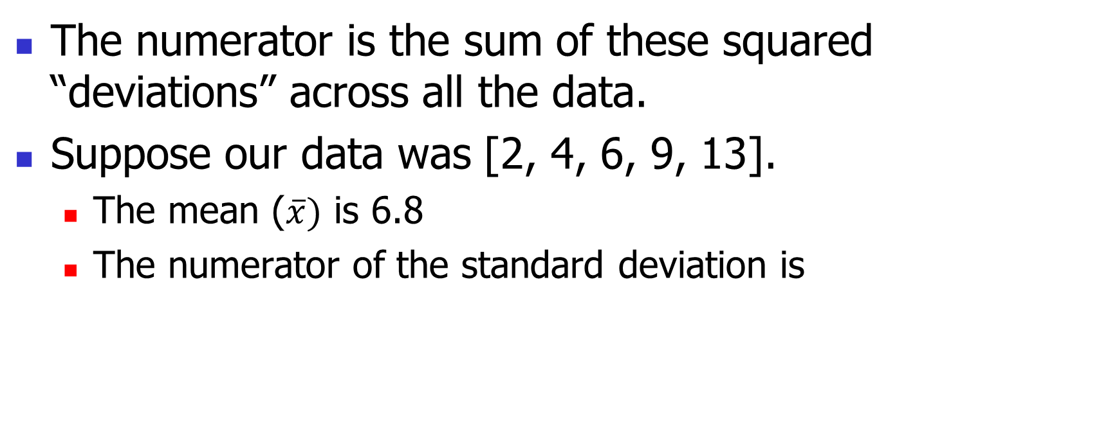
Example Problem: Simple Statistics
The numerator is the sum of these squared “deviations” across all the data.
Suppose our data was [2, 4, 6, 9, 13].
The mean ($\overline{x})$ is 6.8
The numerator of the standard deviation is
$${\left(6.8−2\right)}^{2}+{\left(6.8−4\right)}^{2}+{\left(6.8−6\right)}^{2}+{\left(6.8−9\right)}^{2}+{\left(6.8−13\right)}^{2}=74.8 \\ s=\sqrt{\frac{74.8}{5−1}}=\sqrt{18.7}=4.32$$

Slide 11
Example Problem: Simple Statistics
As you can see, calculating the standard deviation not only requires the mean (which can’t be calculated until all the data is entered), but also each individual data element!
We need some way to remember these values as they are entered

Slide 12
Python Lists
We need a way to store and manipulate an entire collection of numbers.
We can’t just use a bunch of variables, because we don’t know many numbers there will be.
What do we need? Some way of combining an entire collection of values into one object.
We’ve already done something like this before…

Slide 13
Python Lists
>>> list(range(10))
[0, 1, 2, 3, 4, 5, 6, 7, 8, 9]
>>> "This is an ex-parrot!".split()
['This', 'is', 'an', 'ex-parrot!’]
Both of these familiar functions return a collection of values denoted by the enclosing square brackets.
Lists are the most common way of handling collections of data in a Python program.

Slide 14

Lists and Arrays as Sequences
Python lists are ordered sequences of items. For instance, a sequence of n numbers might be called S: S = s₀, s₁, s₂, s₃, …, s_{n-1}
Specific values in the sequence can be referenced using subscripts, e.g. the first item is denoted with the subscript 0 (s₀ )
By using numbers as subscripts, mathematicians can succinctly summarize computations over items in a sequence using subscript variables.
$$\sum_{i=0}^{n−1}{s_{i}}$$

Slide 15
Lists and Arrays as Sequences
Suppose the sequence is stored in a variable s. We could write a loop to calculate the sum of the items in the sequence like this: sum = 0 for i in range(n): sum = sum + s[i]
Almost all computer languages have a sequence structure like this, sometimes called an array.

Slide 16
Lists and Arrays as Sequences
A list or array is a sequence of items where the entire sequence is referred to by a single name (i.e. s) and individual items can be selected by indexing (i.e. s[i]).
In other programming languages, arrays are generally a fixed size, meaning that when you create the array, you have to specify how many items it can hold.
Arrays are generally also homogeneous, meaning they can hold only one data type.

Slide 17
Lists and Arrays as Sequences
Python lists are dynamic. They can grow and shrink on demand.
Python lists are also heterogeneous, a single list can hold arbitrary data types.
Python lists are mutable sequences of arbitrary objects.

Slide 18
Lists Operations
Operator | Meaning
<seq> + <seq> | Concatenation
<seq> * <int-expr> | Repetition
<seq>[] | Indexing
len(<seq>) | Length
<seq>[:] | Slicing
for <var> in <seq>: | Iteration
<expr> in <seq> | Membership (Boolean)

Slide 19
Lists Operations
Except for the membership check, we’ve used these operations before on strings.
The membership operation can be used to see if a certain value appears anywhere in a sequence. >>> lst = [1,2,3,4] >>> 3 in lst True

Slide 20
Lists Operations
The summing example from earlier can be written like this: sum = 0 for x in s: sum = sum + x
Unlike strings, lists are mutable: >>> lst = [1,2,3,4] >>> lst[3] 4 >>> lst[3] = "Hello“ >>> lst [1, 2, 3, 'Hello'] >>> lst[2] = 7 >>> lst [1, 2, 7, 'Hello']

Slide 21
Lists Operations
Lists can be created by listing items inside square brackets.
odds = [1, 3, 5, 7, 9]
food = ["spam", "eggs", "back bacon"]
silly = [1, "spam", 4, "U"]
empty = []
A list of identical items can be created using the repetition operator. This command produces a list containing 50 zeroes: zeroes = [0] * 50

Slide 22
Lists Operations
# month2.py
# A program to print the month abbreviation, given its number.
def main():
# months is a list used as a lookup table
months = ["Jan", "Feb", "Mar", "Apr", "May", "Jun",
"Jul", "Aug", "Sep", "Oct", "Nov", "Dec"]
n = int(input("Enter a month number (1-12): "))
print(f"The month abbreviation is {months[n-1]}.")

Slide 23
Lists Operations
In this program there is a list of strings called months to use as the lookup table.
This line of code is split over two lines – Python knows the list isn’t finished until the “]” is encountered. This makes the code more readable.
Lists, like strings, are indexed beginning with 0. months[0] is "Jan". The nth month is at position n-1.

Slide 24
Lists Operations
It would be trivial to modify this program to print out the entire month name. Just change the lookup list!
months = ["January", "February", "March", "April",
"May", "June", "July", "August",
"September", "October", "November", "December"]

Slide 25
Lists Methods
Method | Meaning
<list>.append(x) | Add element x to end of list.
<list>.sort() | Sort (order) the list. A comparison function may be passed as a parameter.
<list>.reverse() | Reverse the list.
<list>.index(x) | Returns index of first occurrence of x.
<list>.insert(i, x) | Insert x into list at index i.
<list>.count(x) | Returns the number of occurrences of x in list.
<list>.remove(x) | Deletes the first occurrence of x in list.
<list>.pop(i) | Deletes the i^{th} element of the list and returns its value.

Slide 26
Lists Methods
>>> lst = []
>>> lst.append("lists")
>>> lst
['lists’]
>>> lst.append("are")
>>> lst.append("fun")
>>> lst
['lists', 'are', 'fun’]
>>> lst.sort()
>>> lst
['are', 'fun', 'lists']
>>> lst
['lists', 'fun', 'are’]
>>> lst.index("fun")
1
>>> lst.insert(0, "fun")
>>> lst
['fun', 'lists', 'fun', 'are’]
>>> lst.count("fun")
2
>>> lst.remove("fun")
>>> lst
['lists', 'fun', 'are']

Slide 27
Lists Methods
Most list methods either modify the list (e.g. append, sort, remove, extend) or leave the list unchanged and return a value (e.g. count and index).
However, the pop method actually does both!
When you want to remove a specific valued item from a list, remove does the job ,whereas pop removes the item from a given position.
Calling pop without a parameter (e.g. lst.pop()) will always remove the last item from the list.

Slide 28
Lists Methods
Using append is the most common and efficient way of adding an item to an existing list.
It is often used to accumulate a list one item at a time.

Slide 29
Lists Methods
Here is a fragment of code using a sentinel loop to build a list of positive numbers typed by the user:
nums = []
x = float(input('Enter a number: '))
while x >= 0:
nums.append(x)
x = float(input('Enter a number: '))

Slide 30
Lists Methods
Basic list principles
A list is a sequence of items stored as a single object.
Items in a list can be accessed by indexing, and sublists can be accessed by slicing.
Lists are mutable; individual items or entire slices can be replaced through assignment statements.
Lists support a number of convenient and frequently used methods.
Lists will grow and shrink as needed.

Slide 31
Statistics with Lists
One way we can solve our statistics problem is to store the data in a list.
We could then write a series of functions that take a list of numbers and calculates the mean, standard deviation, and median.
Let’s rewrite our earlier program to use lists to find the mean.

Slide 32
Statistics with Lists
Let’s write a function called getNumbers that gets numbers from the user.
We’ll implement the sentinel loop to get the numbers.
An initially empty list is used as an accumulator to collect the numbers.
The list is returned once all values have been entered.

Slide 33
Statistics with Lists
def getNumbers():
nums = [] # start with an empty list
# sentinel loop to get numbers
xStr = input("Enter a number (<Enter> to quit) >> ")
while xStr != "":
x = float(xStr)
nums.append(x) # add this value to the list
xStr = input("Enter a number (<Enter> to quit) >> ")
return nums
Using this code, we can get a list of numbers from the user with a single line of code: data = getNumbers()

Slide 34
Statistics with Lists
Now we need a function that will calculate the mean of the numbers in a list.
Input: a list of numbers
Output: the mean of the input list
def mean(nums): sum = 0.0 for num in nums: sum = sum + num return sum / len(nums)

Slide 35
Statistics with Lists
The next function to tackle is the standard deviation.
In order to determine the standard deviation, we need to know the mean.
Should we recalculate the mean inside of stdDev?
Should the mean be passed as a parameter to stdDev?
Recalculating the mean inside of stdDev is inefficient if the data set is large.
Since our program is outputting both the mean and the standard deviation, let’s compute the mean and pass it to stdDev as a parameter.

Slide 36
Statistics with Lists
def stdDev(nums, xbar): sumDevSq = 0.0 for num in nums: dev = xbar - num sumDevSq = sumDevSq + dev * dev return sqrt(sumDevSq/(len(nums)-1))
The summation from the formula is accomplished with a loop and accumulator.
sumDevSq stores the running sum of the squares of the deviations.

Slide 37
Statistics with Lists
We don’t have a formula to calculate the median. We’ll need to come up with an algorithm to pick out the middle value.
First, we need to arrange the numbers in ascending order.
Second, the middle value in the list is the median.
If the list has an even length, the median is the average of the middle two values.

Slide 38
Statistics with Lists
Pseudocode -
sort the numbers into ascending order
if the size of the data is odd:
median = the middle value
else:
median = the average of the two middle values
return median

Slide 39
Statistics with Lists
def median(nums):
nums.sort()
size = len(nums)
midPos = size // 2
if size % 2 == 0:
median = (nums[midPos] + nums[midPos-1]) / 2
else:
median = nums[midPos]
return median

Slide 40
Statistics with Lists
With these functions, the main program is pretty simple!
def main(): print("This program computes mean, median and standard deviation.") data = getNumbers() xbar = mean(data) std = stdDev(data, xbar) med = median(data) print("\nThe mean is", xbar) print("The standard deviation is", std) print("The median is", med)

Slide 41
Statistics with Lists
Statistical analysis routines might come in handy some time, so let’s add the capability to use this code as a module by adding: if __name__ == '__main__': main()

Slide 42
Pythonic List Manipulation
Python provides list comprehensions as a simple, direct way of creating lists.
Suppose instead of using the sentinel loop in getNumbers, we would like to gfet all of the numbers in a single line of input, similar to the decoder program in Chapter 8.

Slide 43
Pythonic List Manipulation
The simple approach:
inStr = input("Enter numbers below separated by spaces and press <Enter>:\n")
nums = []
for numStr in inStr.split():
nums.append(float(numStr))
The Pythonic approach:
nums = [float(numStr) for numStr in inStr.split()]

Slide 44
Pythonic List Manipulation
nums = [float(numStr) for numStr in inStr.split()]
The right hand side creates a list consisting of the items we get by applying the float function to each string in the split of inStr.
The general form for list comprehension looks like this:
[<expr> for <variable> in <sequence>]

Slide 45
Pythonic List Manipulation
[<expr> for <variable> in <sequence>]
Semantically, this creates a new list, with items formed by evaluating the expression for each value of the variable as it iterates over the sequence.
List comprehensions are handy for building lists out of other sequences and using them produces more concise, readable, and efficient solution than writing the equivalent accumulator loop.

Slide 46
Pythonic List Manipulation
Another trick: make use of functions that take a list an an input parameter.
E.g. to find the maximum value in a list of numbers: maximum = max(nums)
There are also built in functions for minimum (min) and sum.

Slide 47
Pythonic List Manipulation
The mean function can be a one-liner!
def mean(nums): return sum(nums) / len(nums)
We can also rewrite stdDev:
def stdDev(nums, xbar): squared_devs = [(num - xbar)**2 for num in nums] return sqrt(sum(squared_devs) / (len(nums) - 1)
Notice how the accumulator loop has been replaced with a list comprehension

Slide 48
Pythonic List Manipulation
There is one more twist on list comprehensions
You can filter items in the list with an if-clause
[<expression> for <variable> in <sequence> if <condition>]
To see how this can be useful, let’s extend our example with one more function.
Extreme values are called “outliers”, and sometimes we want to identify those values. One measure that’s sometimes used is that any value more than 3 standard deviations from the mean is considered an outlier.

Slide 49
Pythonic List Manipulation
Using our more traditional techniques
def outliers(nums, xbar, s): outs = [] for x in nums: if abs(x - xbar) >= 3 * s:| outs.append(x) return outs
Using a list comprehension
def outliers(nums, xbar, s): return [x for x in nums if abs(x - xbar) >= 3 * s]

Slide 50
Pythonic List Manipulation
While list comprehensions significantly reduce the number of lines of code needed to build a list and make programs easier to understand, don’t get carried away!
def stdDev(nums, xbar): return sqrt(sum([(num - xbar) ** 2 for num in nums])/(len(nums)-1))

Slide 51
Other Data Structures
Python lists allow us to store a collection of data as a sequence of items.
In computer science, a way of organizing and storing data is called a data structure.
Selecting or designing an appropriate data structure is often a crucial step in solving real-world computing problems.

Slide 52
Tuples
A tuple looks like a list except it is enclosed in parantheses () instead of square brackets [].
A tuple is another sort of sequence, which means it is indexable and sliceable.
Tuples are immutable – the items can’t be changed.
If the contents of a sequence won’t change after it’s created, using a tuple is more efficient than using a list.

Slide 53
Tuples
>>> bp = (120, 80)
>>> type(bp)
<class 'tuple’>
>>> bp[0]
120
>>> bp[1]
80
>>> systolic, diastolic = bp
>>> systolic
120
>>> diastolic
80

Slide 54
Tuples
Did you notice the simultaneous assignment?
Another example:
>>> pair = 3, 4
>>> pair
(3, 4)
>>> x, y = pair
>>> x
3
>>> y
4

Slide 55
Dictionaries
While dictionaries aren’t used in this book, we briefly discuss them here since they show up so frequently “in the wild”.
Dictionaries store collections.
Lists allow us to store and retrieve items from sequential collections. We do lookups by its index, or position.
A mapping is collection that allows us to look up information based on arbitrary keys.

Slide 56
Dictionaries
When would this be useful?
Looking up data based on student ID numbers
Locate someone based on phone number
Get a list of users based on zip code
In programming terms, these are examples of key-value pairs. We access the value (student information) based on some key (their ID number).

Slide 57
Tuples
Dictionaries are created by listing key-value pairs inside of curly braces. Keys and values are joined with a “:” and commas separate pairs.
passwd = {"guido":"superprogrammer", "turing":"genius", "bill":"monopoly"} >>> passwd["guido"] 'superprogrammer'

Slide 58
Dictionaries
In general, <dictionary>[<key>] returns the object associated with the given key.
Dictionaries are mutable. >>> passwd["bill"] = "bluescreen“ >>> passwd {'turing': 'genius', 'guido': 'superprogrammer', 'bill': 'bluescreen’}
Notice that the dictionary prints out in a different order than it was created. Mappings are unordered.

